Slide 1
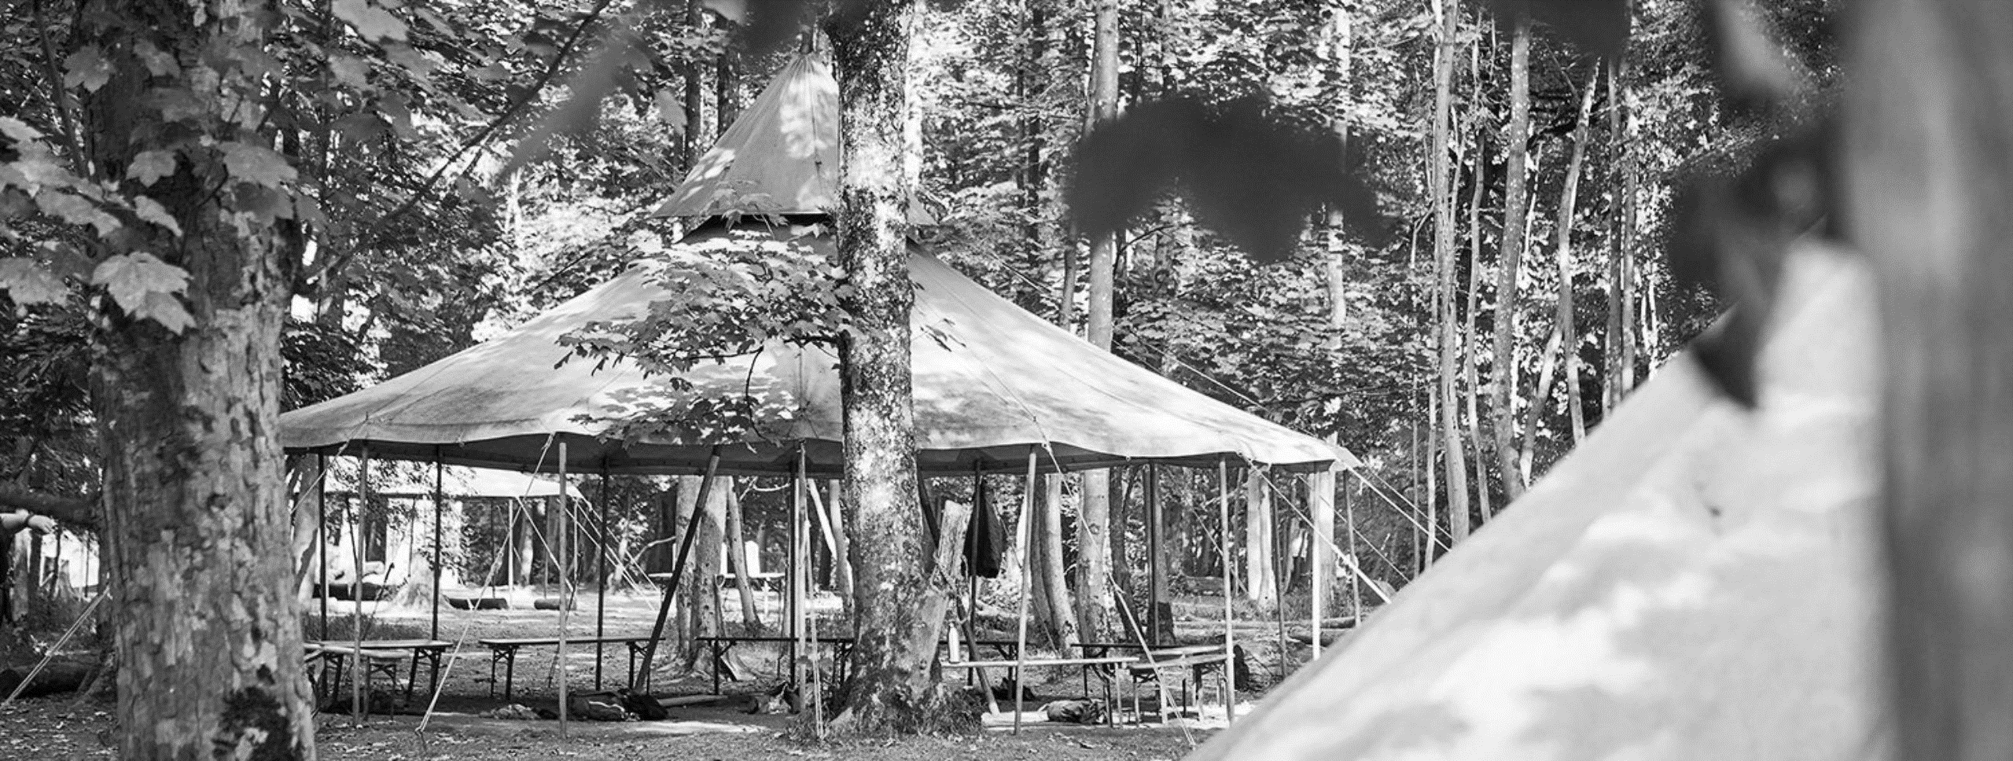
Year 4 Bushcraft 3rd – 4th July
https://youtu.be/kHqVC1RceO0

Slide 2
Why Bushcraft?
Parent voice carried out in 2022/2023 showed that parents were keen for their children to
Experience a residential in a younger year group
Experience life skills/bush craft style visit
For visits to provide value for money for the experience
The Bushcraft Company camp at Castle Howard doesn’t just give students a taste of the outdoors – it immerses them in it.
The course takes place in chestnut, spruce and pine woodlands. These form part of Castle Howard’s magnificent Yorkshire estate.
Bushcraft courses help children to build vital skills that are not just relevant when in the great outdoors. The focus is on social and personal development. The woodland setting provides the perfect backdrop for pupils to try new experiences. These include fire lighting, shelter building, camouflage and concealment.

Slide 3
Respect
Problem-solving
Achievement
Team-work
Fun
New skills
Challenges

Slide 4
Staff
Mrs Kendall – Deputy Headteacher, First Aid and DSL
Mrs Hemingway – Key Stage Lead, First Aid and DSL
Mr Davison– Paediatric First Aider
Miss Williams – First Aider
Miss Kelly and Mrs Marriott will be the point of contact between parents and the group when on visit.

Slide 5
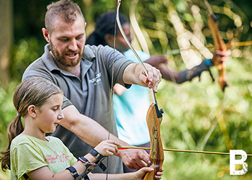
Staff
While away, children will learn from experienced ‘bushcrafters’. Instructors will teach the children how to identify different trees and plants. They’ll also expand their knowledge of traditional and modern uses of trees.
Each group will have the same instructor the two days. This allows them to build a relationship with the children so they get the most from the visit as possible.
All staff are required to pass enhanced DBS checks, and also have a great deal of experience of working on camps of this kind. Every staff member receives extensive in-house training, as well as obtaining qualifications from national governing bodies for specialised activities, including archery and swimming. All Camp Leaders are first aid trained, and our Field Cooks have food hygiene certificates. Throughout the year our staff are regularly monitored, and we have a full time Safeguarding officer on hand to ensure that every child is kept safe.
There are also Operational Managers always on call who have an over-arching responsibility for health and safety and safeguarding decisions.

Slide 6
Safety
Food
Food is procured from reputable sources and stored safely. Food hygiene is controlled by trained staff, our kitchens are also inspected by the food hygiene agency. Comprehensive first aid kits and emergency medical kits are nearby on all courses and any incidents are managed through a detailed incident, emergency, and communication plan.
Accreditations
As an organisation that works with young people we are inspected and members of several governing bodies, which include:
BAPA (British Activity Provider Association) – who set the standard for Quality, Safety and value for money activity centres and residential and day camp providers.
The Council for Learning Outside the Classroom (LOtC) is the national voice for learning outside the classroom. This organisation ensures that the quality of our outdoor education provision meets their stringent standards. Our certificates are available to download below and will also be sent to you upon booking.
Adventuremark is a non-statutory safety scheme devised by the Adventure Activity Industry Advisory Committee (AAIAC) for providers of adventurous activities that are outside the scope of the Adventure Activity Licensing regulations.
These inform school’s own risk assessments which are submitted to the Local Authority.

Slide 7
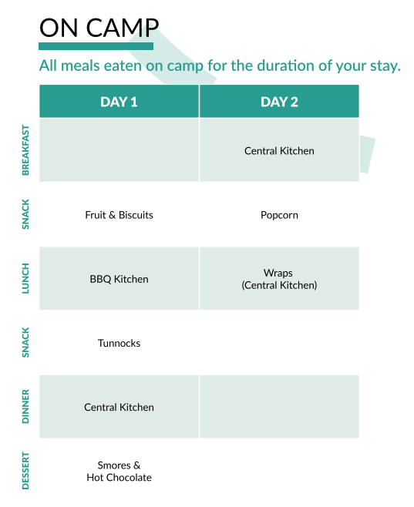
Food
Some meals are cooked on camp, over the open fire. And some meals are cooked by our head chefs over at the central kitchen – this is a larger kitchen in the woods where the students will go for dinner and enjoy a range of hearty food cooked in our camp kitchen.
ON CAMP - Students will have the opportunity to cook over their fire, roast marshmallows and enjoy hot chocolate before bed.

Slide 8
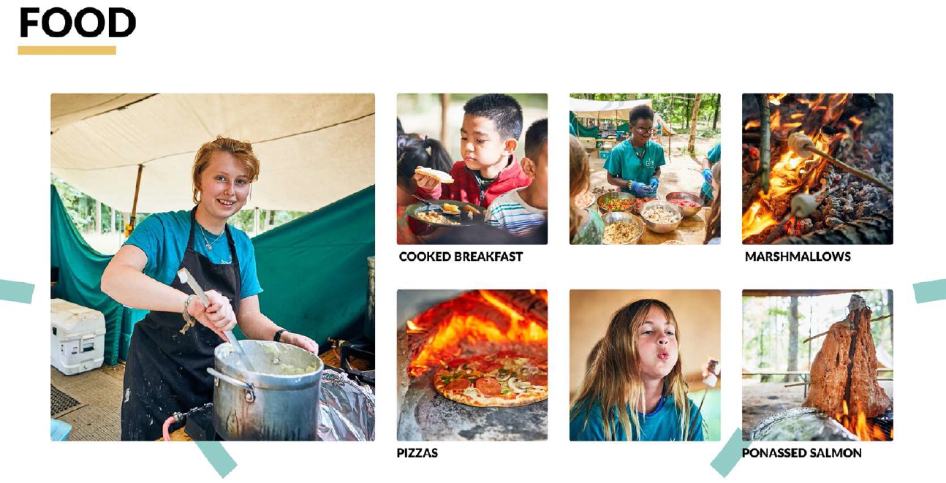
CENTRAL KITCHEN A larger field kitchen a short walk from camp, where students are served their meals and eat together away from the main camp area.

Slide 9
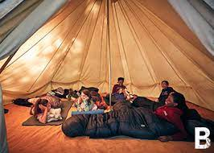
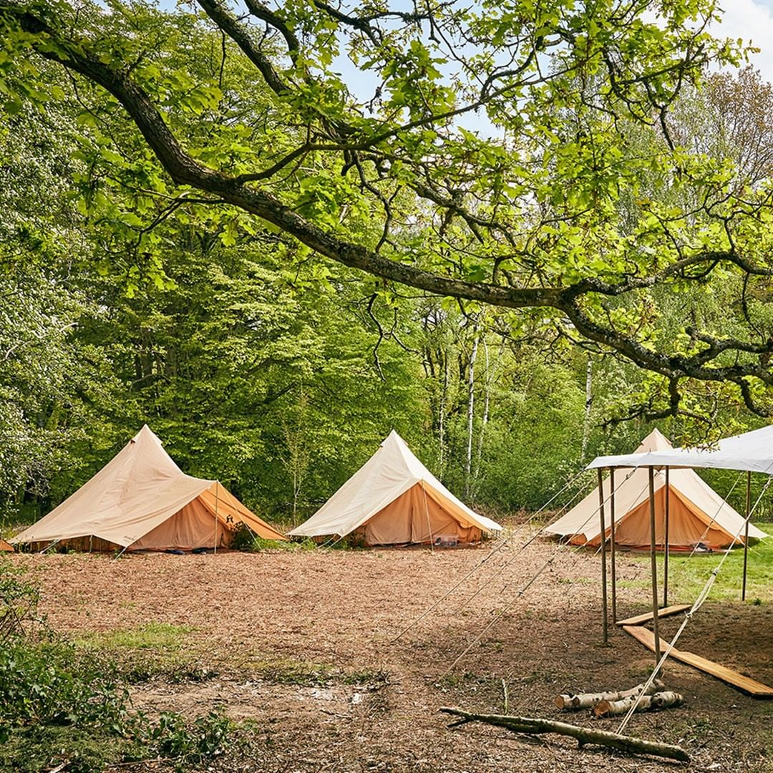
Accommodation
Children will sleep in same-sex tents with approx. 8-10 people in one tent.
Dane Royd staff are on the same site in their own tents.
2 members of Bushcraft staff are on duty all night in the centre of camp – near the camp fire.
If any child wakes in the night, Bushcraft staff will wake school staff who will support the child.
If a child needs the toilet in the night, it is a short walk to the porta-loos in camp. Children will need a torch or headlight for this reason.
We will encourage children to go to the toilet before bedtime to avoid waking in the night.

Slide 10
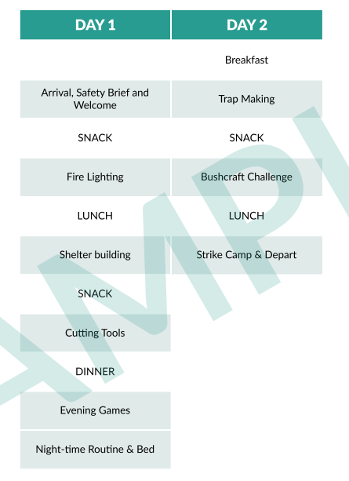
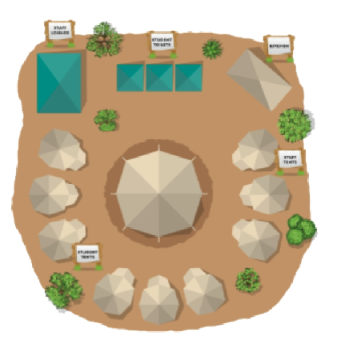

Slide 11
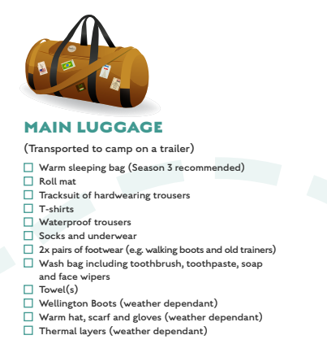
Things to take
This is a suggested list!
They will get dirty, so please send them in old clothes. Don’t feel the need to buy new.
Ask friends to borrow items rather than buy new.
I will send a ParentPay the week before the visit with weather dependent information. I would plan for sun-hats and sun-cream.
It is better to take a large rucksack or small holdall as they will have their luggage in the tents, so the smaller and squishier the better!

Slide 12
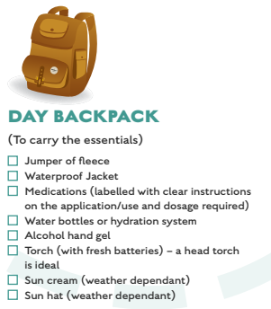
On arrival we will be greeted by our Camp Leader who will walk our group to camp; our main baggage will be transported for you by the Bushcraft Estate Team.
Children need to have a rucksack ready for our walk to camp with a water bottle and water-proofs/hat/suncream.
The walk to camp could be a 15-30 minute walk from the arrivals area. Make sure the essentials are packed in your day bag, you might not be back with your main luggage until later on that day.
A top tip for long hair; braids/plaits will be ideal so they can stay in for the whole visit.

Slide 13
Things not to take
Technology
We want the children to fully embrace the outdoors and being away from technology. Our staff and school will be the contact between your child and you if needed. We will also take photos of the experience which we will share via X, however please be mindful our purpose of the visit is to support your child gain the most from the visit and we will only upload photos when it is appropriate in the timetable to do so.
Snacks
Children are not allowed to bring snacks onto site. We will make sure the children have plenty of snacks and stay hydrated. Plus, sweet treats in tents will only attract creepy crawlies!
Money
Everything is included on site, so bringing money is not necessary.

Slide 14
Departing on Thursday 3rd July
Children will come on to the school playground at 8:30am
They can drop their luggage (not their rucksack) at the coach where school staff will be.
Children, with their grown up, make their way to the school hall where they will ‘check-in’
At check in you will need: Your updated medical record (I will send this home the week before)
Any medication be handed in to staff (named and labelled)
Show staff your inhaler (for those with asthma)
Children will then go to their classrooms to register and go to the toilet. We will then head to the coach at approx., 9am. Parents are welcome to wave us off.

Slide 15
Returning on Friday 4th July
We will leave Castle Howard at 2pm.
We hope to be back at school at 4pm, however this is traffic dependent!
We will tweet when we are approx. 30 minutes away.
When we arrive back, your child’s bag will be lined up against the brick wall. We ask for grown ups to locate their child’s.
We will then hand children off the coach one at a time.
If you are asking someone else to collect your child, please share this information with Mrs Hemingway as visit lead before the visit, or contact the school office on the Friday if arrangements change. Without this information, we will not be able to release your child.

Slide 16
Staying in Touch
The visit lead, Mrs Hemingway will be in contact with school during the visit.
Miss Kelly and Mrs Marriott will be on call. Should you need to contact the visit, we ask that you contact the main school office during the normal school day, or email Miss Kelly outside of these hours in case of an emergency.
Staff will endeavour to share updates via X #Dane RoydVisits
(If you have previously not given permission for your child to be on X, and would like to update this permission for the visit, please speak to a member of staff)
https://youtu.be/kHqVC1RceO0

Slide 17
Any Questions

