Slide 1
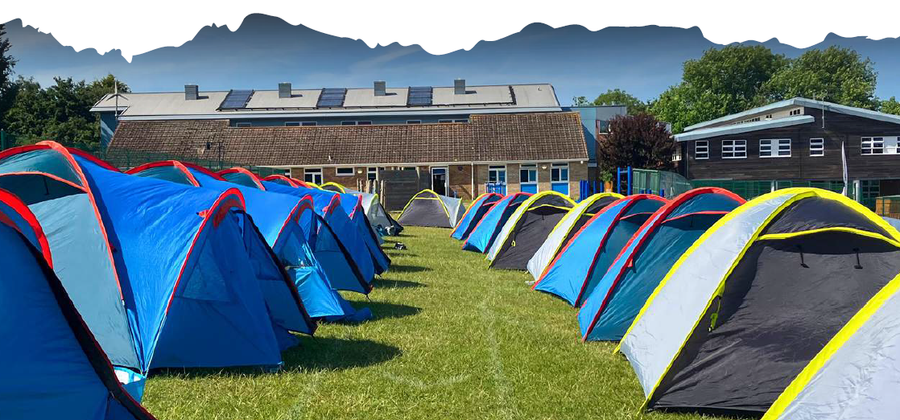
Year 3 Big Camp 6th – 7th June
https://youtu.be/l2XJ7ousbeM

Slide 2
Why Big School Camp?
Parent voice carried out in 2022/2023 showed that parents were keen for their children to
Experience a residential in a younger year group
Experience life skills/camping style visit
For visits to provide value for money for the experience
The Big School Camp is unique! They create a full-sized, temporary campsite within our school grounds, with a host of amazing outdoor activities for children to enjoy.
They will build their resilience, engage with nature and strengthen their teamwork skills.
Big School Camps deliver unrivalled fun. Their fully supervised activities include Bushcraft, Life Skills, Team Building, Fire Lighting all of which present both mental and physical challenges. There may also be a bit of singing along the way too!

Slide 3
Why Big School Camp?
Having a Big School Camp situated in the school grounds reduces the cost of providing these enriching experiences for children. Each camp is carefully tailored to meet the particular needs of each individual school, so each one is truly unique! They consult with the school during the planning stages to ensure that every criteria is met, with consideration given to making the activities accessible for all children.
Big School Camp are breaking the mould and offering children across the country the opportunity to try something new to push themselves out of their comfort zone, to learn new skills and to work as a team. We all know the value of these experiences in helping children to build their confidence and develop into happy, healthy learners.

Slide 4
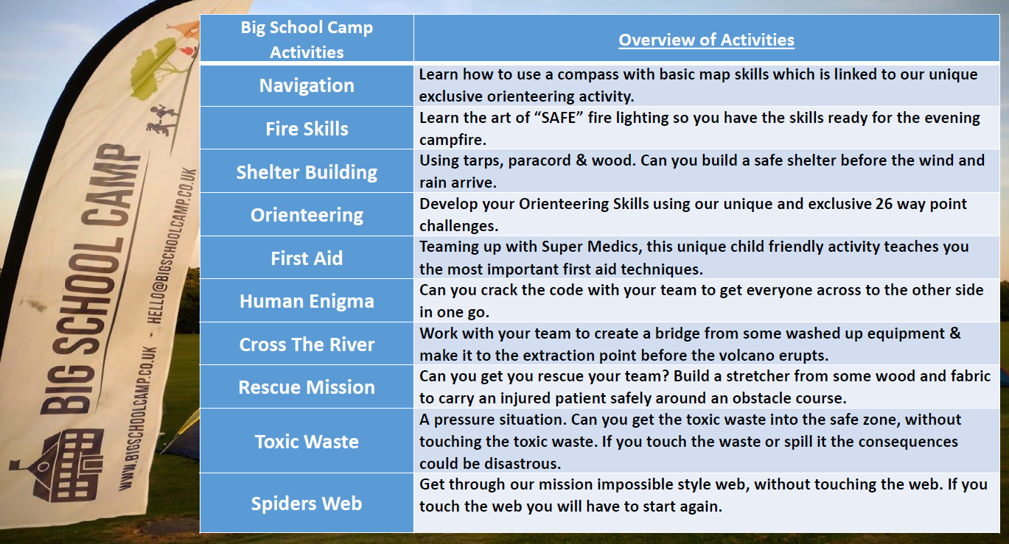
Respect
Problem-solving
Achievement
Team-work
Fun
New skills
Challenges

Slide 6
Staff
Mrs Kendall
Mrs Hemingway
Mr Davison
Miss Kelly
Miss Lodge
Mrs Dyson

Slide 7
Food
At Big School Camp, they know that food is a fundamental for children. They encourage school to, where possible, use local providers and businesses to source produce for the camp.
Children will enjoy a picnic style lunch, snacks throughout the day, a tasty evening meal, and a yummy breakfast before heading home!
ON CAMP - Students will have the opportunity to roast marshmallows and enjoy hot chocolate before bed.

Slide 8
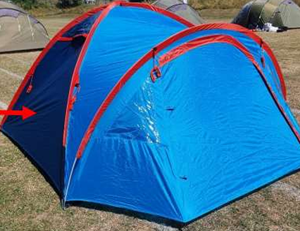
Accommodation
Children will sleep in same-sex tents with approx. 4 people in one tent.
Dane Royd staff are on the field too, in their own tents which will be placed around children’s tents.
One member of Dane Royd staff will be awake at all times through the night.
Members of Big Camp staff also remain on site.
If any child wakes in the night, school staff will support the child.
If a child needs the toilet in the night, they will alert school staff. Children will need a torch or headlight as they will need to walk to the school building.
We will encourage children to go to the toilet before bedtime to avoid waking in the night.

Slide 9
Things to take
Sun cream & sun hat
Water Bottle
Trousers – we recommend thick non polyester trousers, chinos or jeans or thick tracksuit bottoms should be worn during the Fire Skills activity for safety.
Certain activities are No Shorts for safety.
Loose comfortable clothing for activities
Hair bands - hair must be tied up
No Jewellery, including watches, fit bits etc
Warm Jumper
Trainers for activities- NO open shoes
Sleeping bag
Pillow
Roll-mat
Bed time clothing
This is a suggested list!
They will likely get dirty, so please send them in old clothes. Don’t feel the need to buy new.
Ask friends to borrow items rather than buy new.
I will send a ParentPay the week before the visit with weather dependent information. I would plan for sun-hats and sun-cream.

Slide 10
Things not to bring
Technology
We want the children to fully embrace the outdoors and being away from technology. Our staff and school will be the contact between your child and you if needed. We will also take photos of the experience which we will share via X, however please be mindful our purpose of the visit is to support your child gain the most from the visit and we will only upload photos when it is appropriate in the timetable to do so.
Snacks
Children are not allowed to bring snacks onto site. We will make sure the children have plenty of snacks and stay hydrated.
Money
Everything is included on site, so bringing money is not necessary.
If you do need to contact anyone in case of an emergency, please use the main school number or in the evening you can call on a mobile #number .

Slide 11
Friday 6th June
Children will come into school at the normal time (in their camping clothes!)
Parents should drop their children off at the main school hall where they will be ‘checked in’.
You will need to stay with your child until they have been checked in.
At check in you will need: Your updated medical record (I will send this home the week before)
Any medication be handed in to staff (named and labelled)
Show staff your inhaler (for those with asthma)
The camp will then start at 9am!

Slide 12
Saturday 7th June
Children will need to be collected from the main school gates at 10am on Saturday morning.
If you are asking someone else to collect your child, please share this information with Mrs Hemingway as visit lead before the visit, or contact the school office on the Friday if arrangements change. Without this information, we will not be able to release your child.

Slide 13
Any Questions

